Slide 1

HR Analytics Dashboard Integrated with Alerts and Chatbot
Summer Internship Project by: Boddapati Kanchana (24MBMB02)

Slide 2




Executive Summary
Internship Foundation
Core Objective
Completed at Innodatatics, Hyderabad, focusing on practical application of data science in the HR domain.
To develop an advanced, interactive HR analytics system featuring real-time alerts and a Natural Language Processing (NLP)-powered chatbot.
Key Tools Utilised
Intelligent Outcome
Leveraged Power BI for rapid prototyping and Python Dash for integrating dynamic features and custom logic.
The resulting dashboard facilitates swift, data-driven decisions, transforming traditional HR reporting.

Slide 3
Background and Need for the Study
Limitations of Static Reporting
Demand for Real-time Insights
Traditional HR relies heavily on manual, static reports and spreadsheets. This process often leads to delayed decision-making, which is critical when managing issues like high attrition risk.
There is an urgent need in modern enterprises for dynamic, interactive tools that provide insights instantly, moving away from retrospective analysis to predictive and prescriptive action.

Slide 4





Objectives
Dynamic HR Dashboard
Attrition Alert System
Real-time Visual Alerts
Develop a comprehensive dashboard covering demographics, employee tenure and retention risk prediction.
Implement a mechanism for manual email alerts to notify managers immediately regarding high-risk attrition cases.
Create immediate visual indicators within the dashboard to reflect new data updates and critical threshold breaches.
Advanced Filtering
NLP Chatbot Integration
Incorporate sophisticated filtering and drill-down functionalities to enable deep-dive analysis across various HR data dimensions.
Integrate an NLP-based chatbot to provide self-service analytics, allowing users to query data using natural language.

Slide 5

Company Profile: Innodatatics
Leading the Charge in Data-Driven Solutions
Prominent analytics and AI solutions firm located at T-Hub, Hyderabad, a hub for innovation.
Founded by CEO, Mr. Shirish G., with a vision to deliver world-class, impactful data-driven solutions.
Specializes in leveraging Business Intelligence and Machine Learning & AI to solve complex business problems.
Key Industry Focus: Retail, Healthcare, and Finance Analytics.

Slide 6





Conceptual Framework and Methodology
Requirements
Prototype
Define KPIs and project scope
Design Power BI dashboard mock
Data Prep
Alerts & Chatbot
Collect, clean, and validate data
Integrate email alerts and NLP bot

Slide 7
Key Features of the Dashboard
Interactive Visuals
1
Dynamic charts and graphs that respond instantly to user input and filtering.
Critical KPIs
2
Direct monitoring of Productivity, Employee Tenure, Job Satisfaction scores- and Salary distribution.
Real-time Alerts
3
Automated visual notification triggered every 2 minutes when new data is processed.
Retention Email Trigger
4
Manual action available within the dashboard to trigger pre-composed emails to managers for high-risk employees.
Chatbot Interface
5
Supports both predefined quick queries and more complex, custom HR data requests.

Slide 8
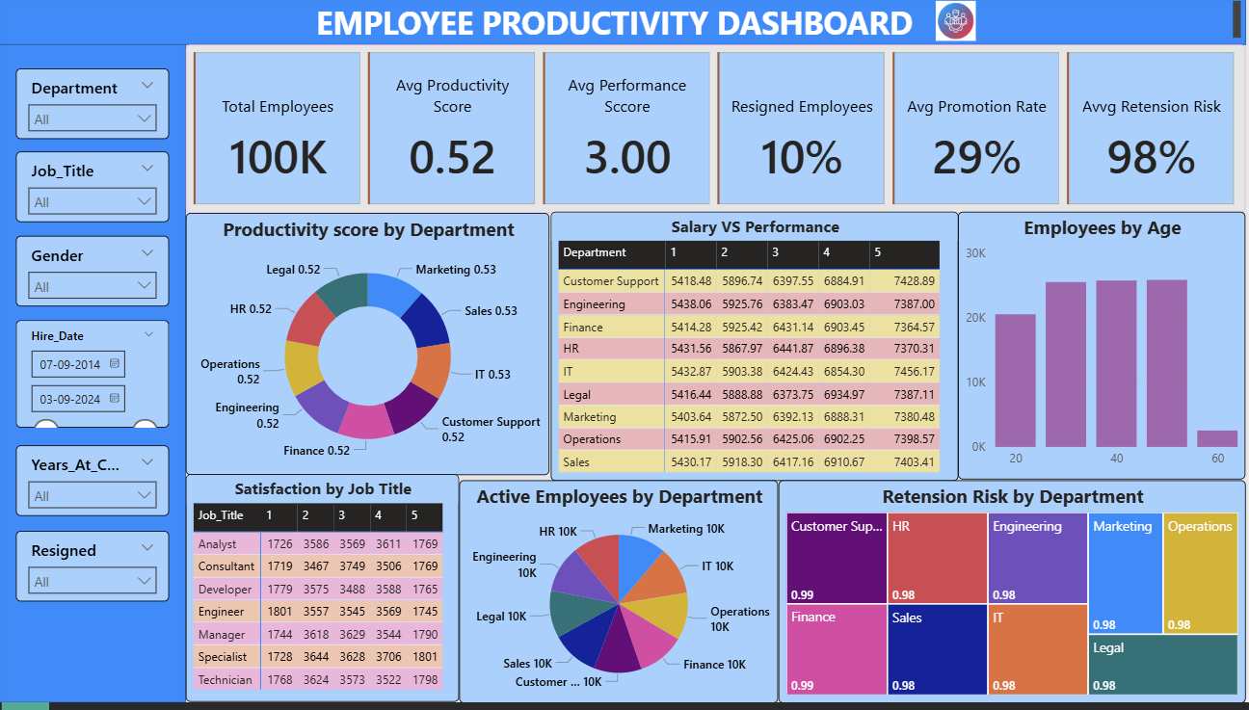

Slide 9
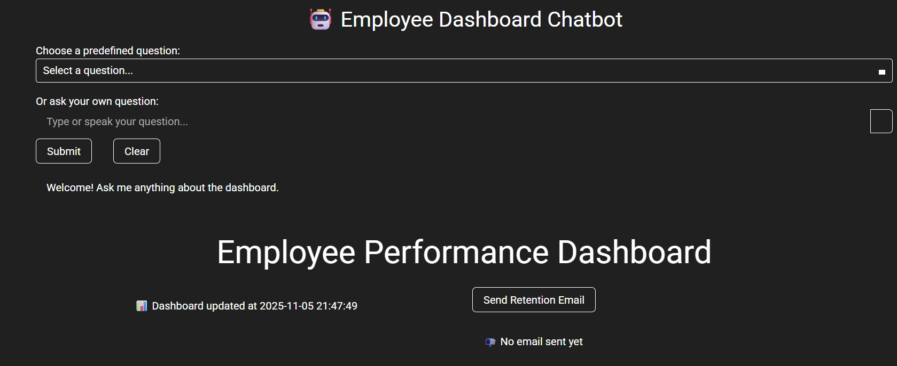
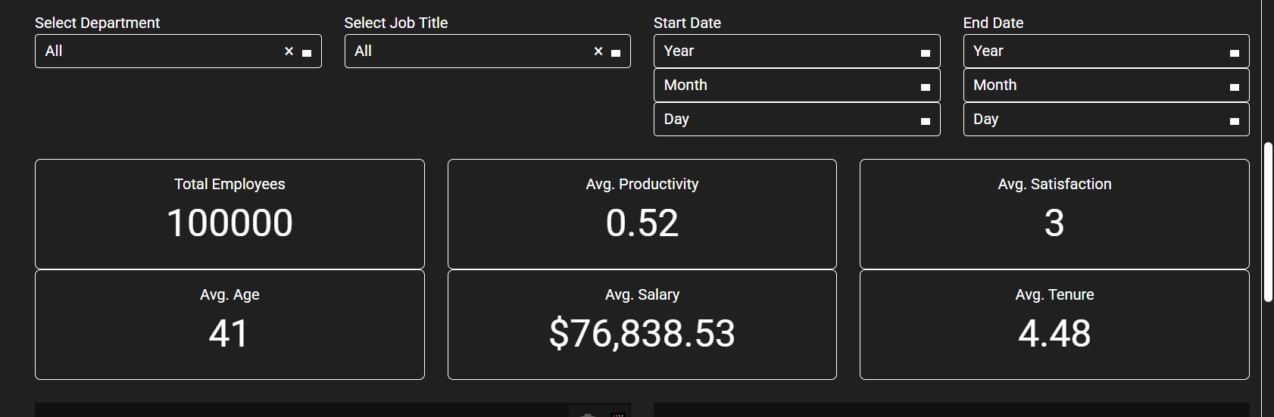

Slide 10
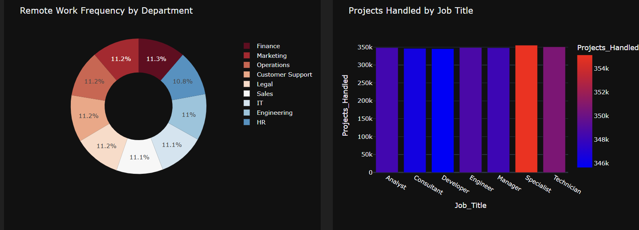
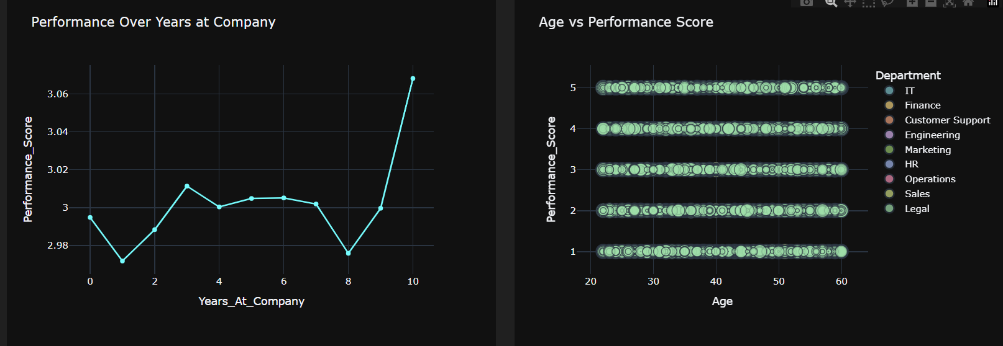
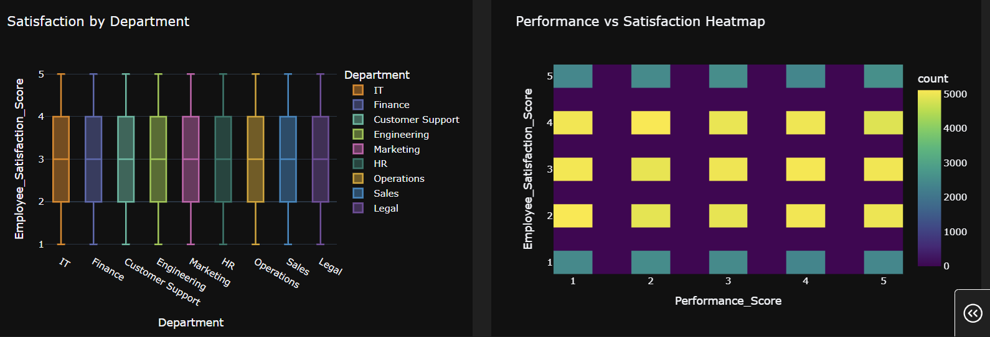

Slide 11
Challenges Encountered and Key Learnings
Challenges Overcome
Key Learnings
Data cleaning & KPI selection
Debugging Python dashboard
Python Dash, Plotly, Pandas, NLP
Email automation & chatbot integration
Data preprocessing & dashboard design
Real-world HR analytics application
Improved communication & teamwork skills

Slide 12


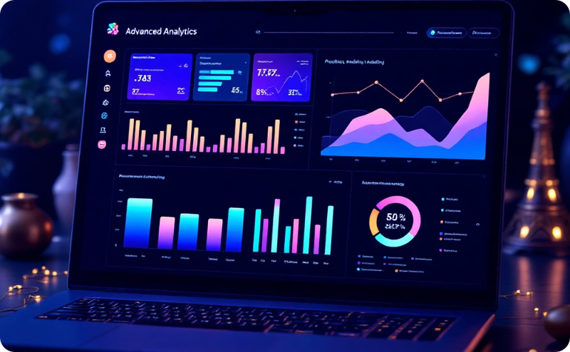

Suggestions and Future Scope
Live HRMS Integration
Voice & Multilingual Chatbot
Predictive Attrition Models
Cloud Deployment for Scale

Slide 13


